Slide 1

SVKM’s Institute of Technology, Dhule Department of Information Technology
Mini Project Presentation
On
“Fruit Recognition System”
By
06 - Shantanu Anil Bhadage
13 - Anuj Dnyaneshwar Deshmukh
15 - Durgesh Bhaskar Gaikwad
57 - Yogesh Prakash Wani
Guide
“Prof. Sachin Kamble”
Day and Date of Review : Saturday, 5 Nov 2022

Slide 2
Contents
Project Group
Project Motivation
Introduction
Literature Survey
System Architecture
Design Diagrams
Conclusions
References

Slide 3
Project Details
Project Title : Fruit Recognition System
Project Domain :
Project Group Members:
T2054491246052, Shantanu Anil Bhadage
T2054491246007, Anuj Dnyaneshwar Deshmukh
T2054491246016, Durgesh Bhaskar Gaikwad
T2054491246062, Yogesh Prakash Wani

Slide 4
Motivation
The goal of this research was to find a simple way to improve the performance of the recognition procedure under mobile environment and at the same time preserve the accuracy. The proposed method uses simple feature information like color, shape and texture and transforms that information into a code that can be used as a search key for the fruit.

Slide 5
Problem statement
Since fruit monitoring plays an important role in health-related problems, it is becoming more essential in our day-to-day life.
The project is able to recognize the fruit based on the features like shape, color, and texture. This increases the knowledge of common people about some rare and unknown fruits.

Slide 6
Aim and Objectives of the Project
The main objective of this project is to detection of fruit and estimate calories using the image.
This just focus the image of particular fruit and identify the fruit.
The identifying the fruits and the calories/nutrients from an image is quite an interesting field with various applications.

Slide 7
Introduction
Today, many food companies around the world get help from computer-aided programs and use certain technologies in their operations in order to save time and cost.
Classification of fruits and plants according to their types and characteristics is one of the applications that can make serious contributions to the profit rate of such businesses.
Classification of fruits and plant according to their types and characteristics is usually done by hand and eye.
This method can cause great losses in terms of time, cost and labor.
Such problems can be eliminated by using pattern recognition methods.
One of the biggest challenges in developing a fruit detection and recognition system is the limited differences between the two fruits in the image.

Slide 8
Literature Survey/Related work
Sr. No. | Reference Name (Write Paper Title) | Seed Idea/ Work description | Problems found
1 | IEEE 2017; “ Image Processing System for Automatic Segmentation and Yield Prediction of Fruits Using Open CV “ | In this paper an image processing system is developed for the yield prediction of fruits.
2 | Research Gate 2019; “ A fruits recognition system based on a modern deep learning technique “ | In these paper an ML algorithm and DNN and the Fruit 360 dataset is used to identify the fruit in image. | The results show that the proposed model is 95% accurate.
3 | IEEE 2020; “ Fruit Recognition and Classification with Deep Learning Support on Embedded System (fruitnet) “ | The classification process ConNN deep learning model is made. The proposed model is developed on Keras platform. For the realization of the study in real life, 20 different fruits in 2 different data sets are tested. | The data sets used in the training of the models were increased by increasing the number of fruits and the images of each fruit, so data sets were enriched.
4 | IEEE 2021; “ Computer Vision Based Local Vegetables Recognition “ | Proposed some machine learning methods with computer vision approach for local vegetables recognition and identification. | The dataset uses almost 1118 training images.
Minimum FIVE references should be there from literature.

Slide 9
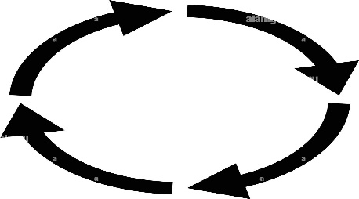
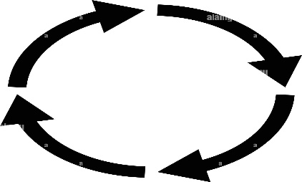
Architecture of the System
Input Fruit Image
Pre-processing
Feature
Extraction
Result
Accuracy Report
Comparison

Slide 10

UML diagrams
USE CASE DIAGRAM
Take Image
Compare
Process
Calculate Accuracy
User
Database
Generate Result
View Result

Slide 11
Conclusions
The proposed method can process, analyze, classify and identify images, which are selected and sent in to the system based on color, shape and size features of the fruit. The flask algorithm is the appropriate and effective classification algorithm to be used in the Fruits Recognition System. The recognition system that has been developed is able to recognize all the test fruit images which are being selected by user or system tester from the fruit selection menu on the system.

Slide 12
References
IEEE – T. Gayathri Devi , Dr. P. Neelamegam , S. Sudha. " Image Processing System for Automatic Segmentation and Yield Prediction of Fruits Using Open CV “, 2017
Research Gate – Dang Thi Phuong Chung and Dinh Van Tai. "A fruits recognition system based on a modern deep learning technique," Journal of Physics, 2019.
IEEE – Gianluigi Ciocca , Giovanni Micali , and Paolo Napoletano, " State Recognition Of Food Images Using Deep Features ", VOLUME 8, Feb 2020
IEEE – Md. Robel Mia, Narayan Ranjan Chakraborty, " Computer Vision Based Local Vegetables Recognition", Sep 2021

Slide 13
Thank You

